Slide 1
Frequency Comb Generation via Physics-Informed Bayesian Optimization
Zheming Li, Lucas Fernandez-Alcazar, Zin Lin,
Tsampikos Kottos
Notes:
Self-introduction

Slide 2
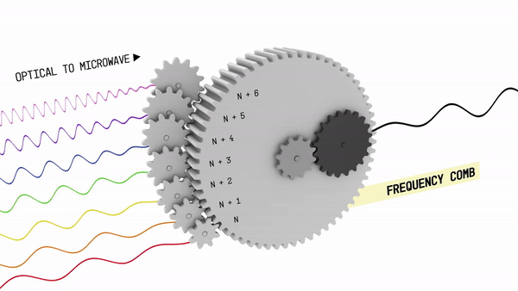
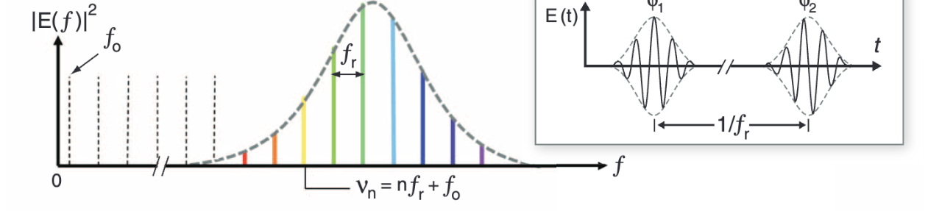

Slide 3
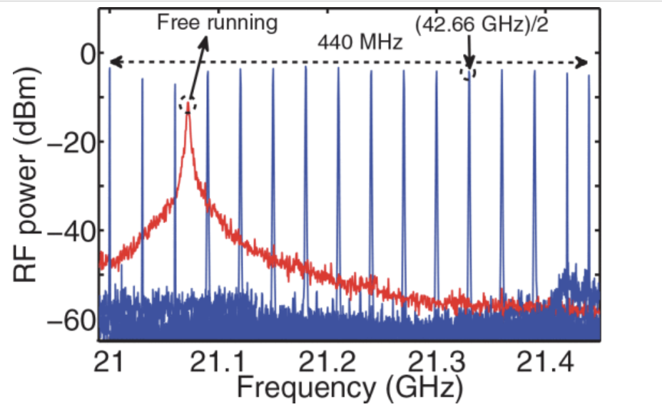

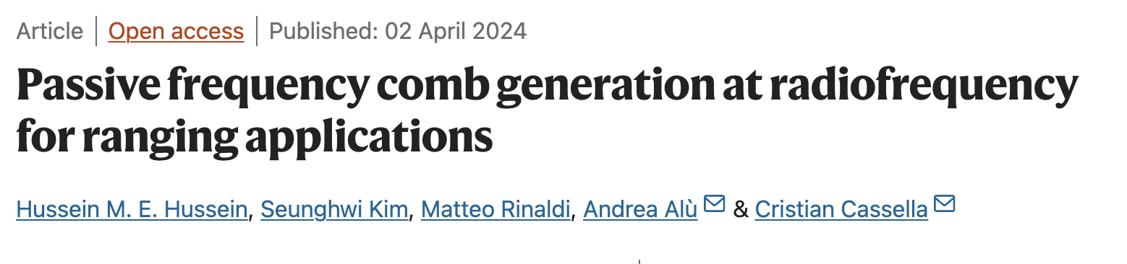
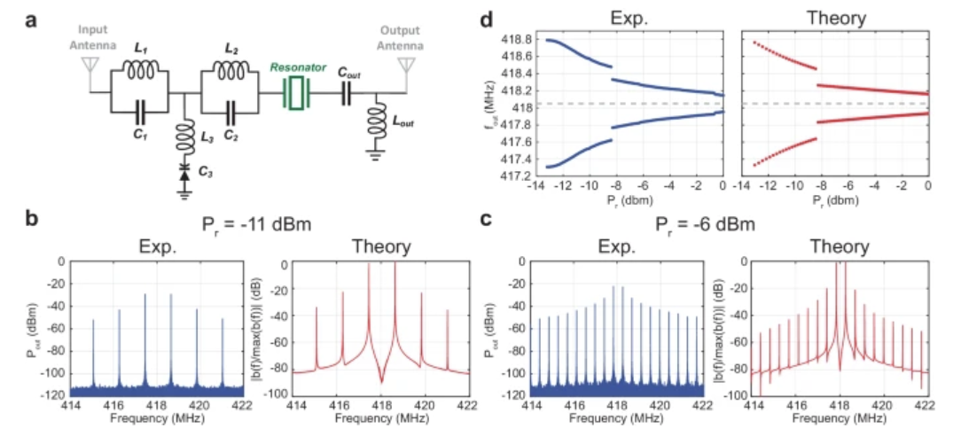
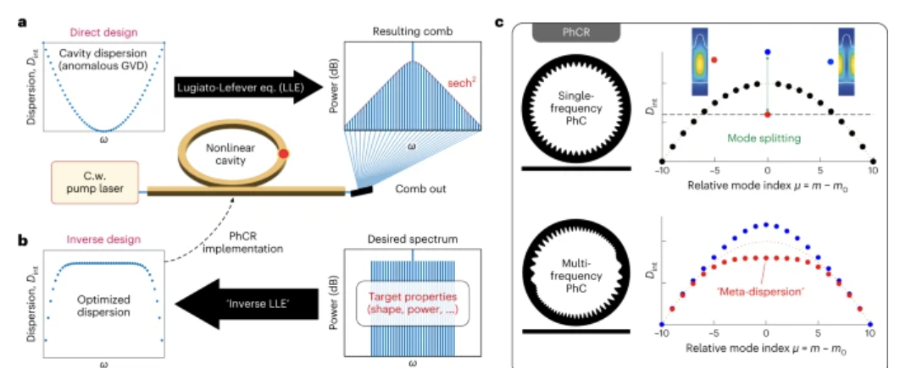
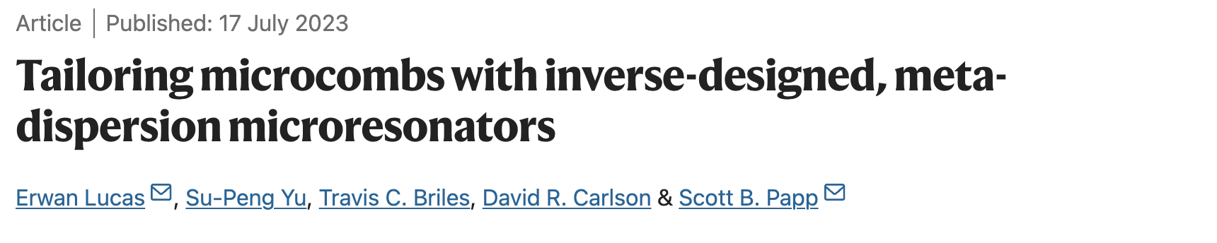
Recent Developments

Slide 4
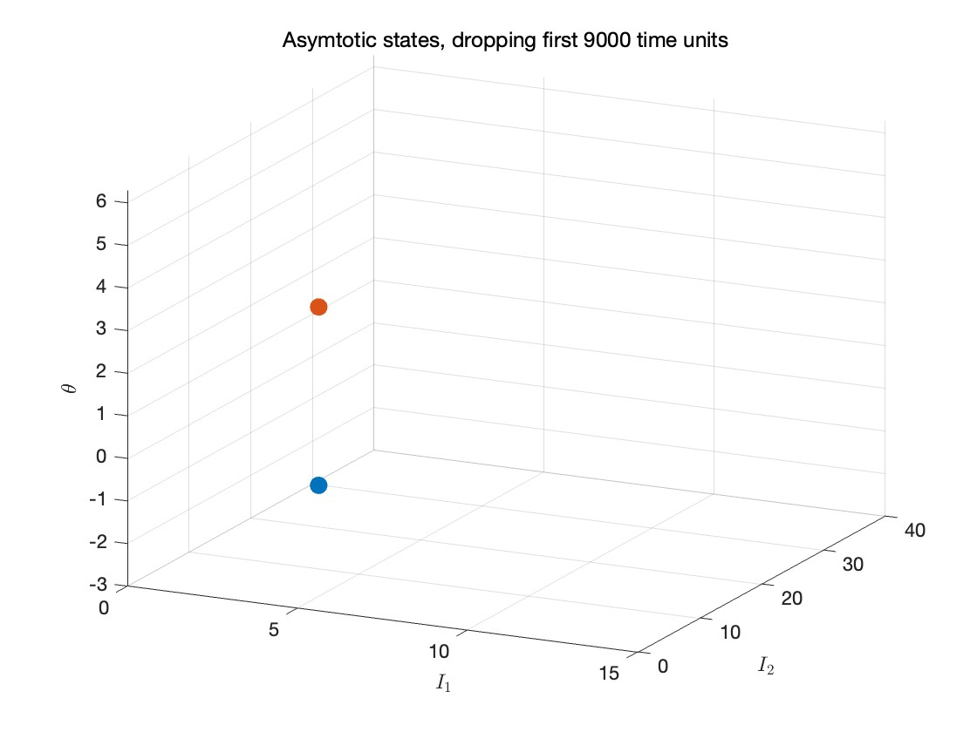
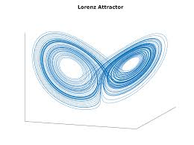
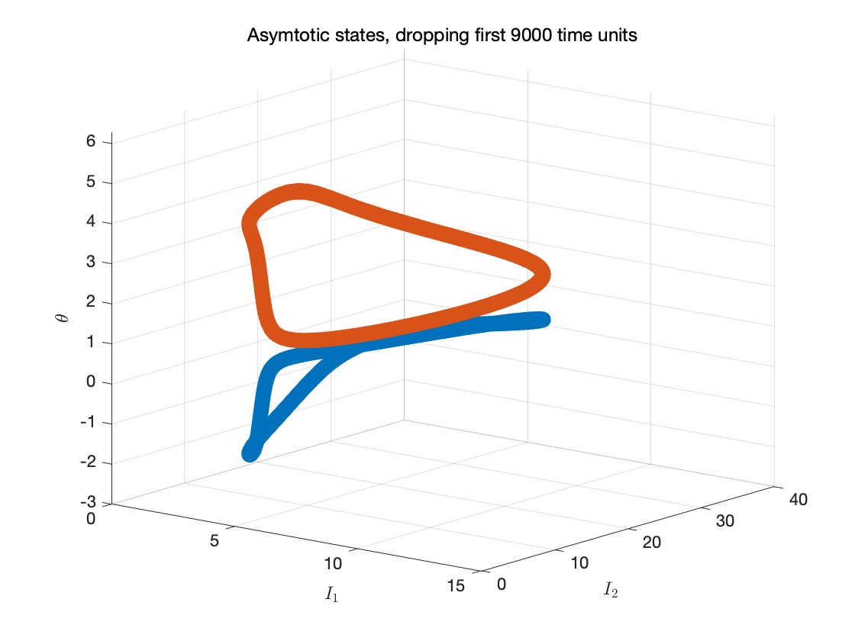
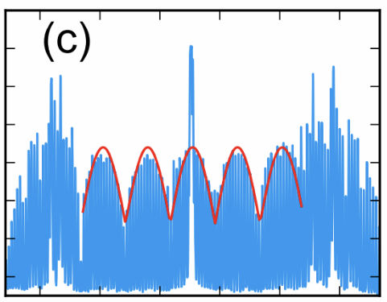
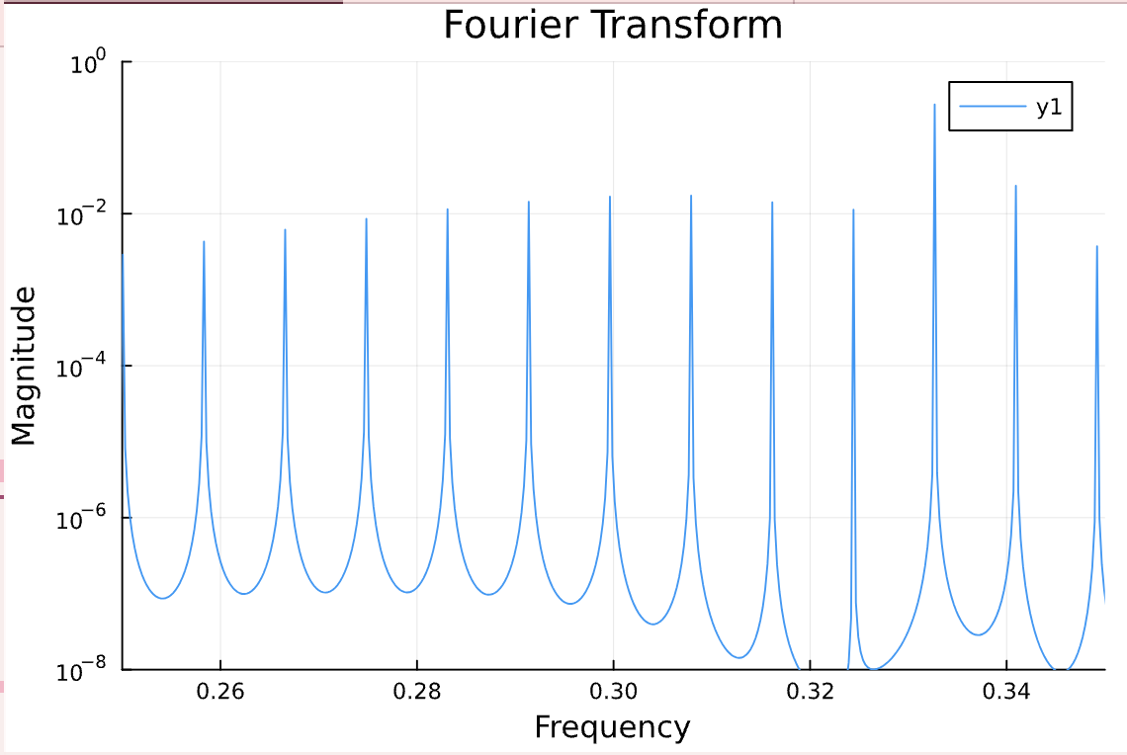
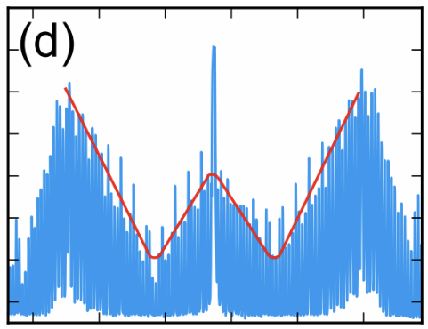

Utilizing Dynamical Systems for Frequency Combs
$$\frac{d\vec{ψ}}{dt}=f(\vec{ψ};\vec{η})$$
Complexity
Fixed points
Limit cycles
Chaos
Inverse Design of Limit Cycles
Notes:
Mention that f is nonlinear

Slide 5
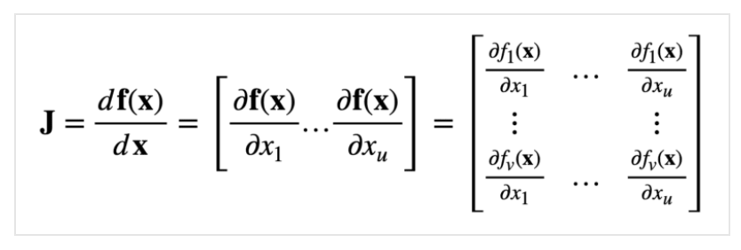
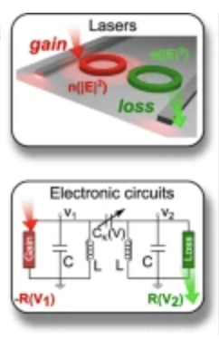
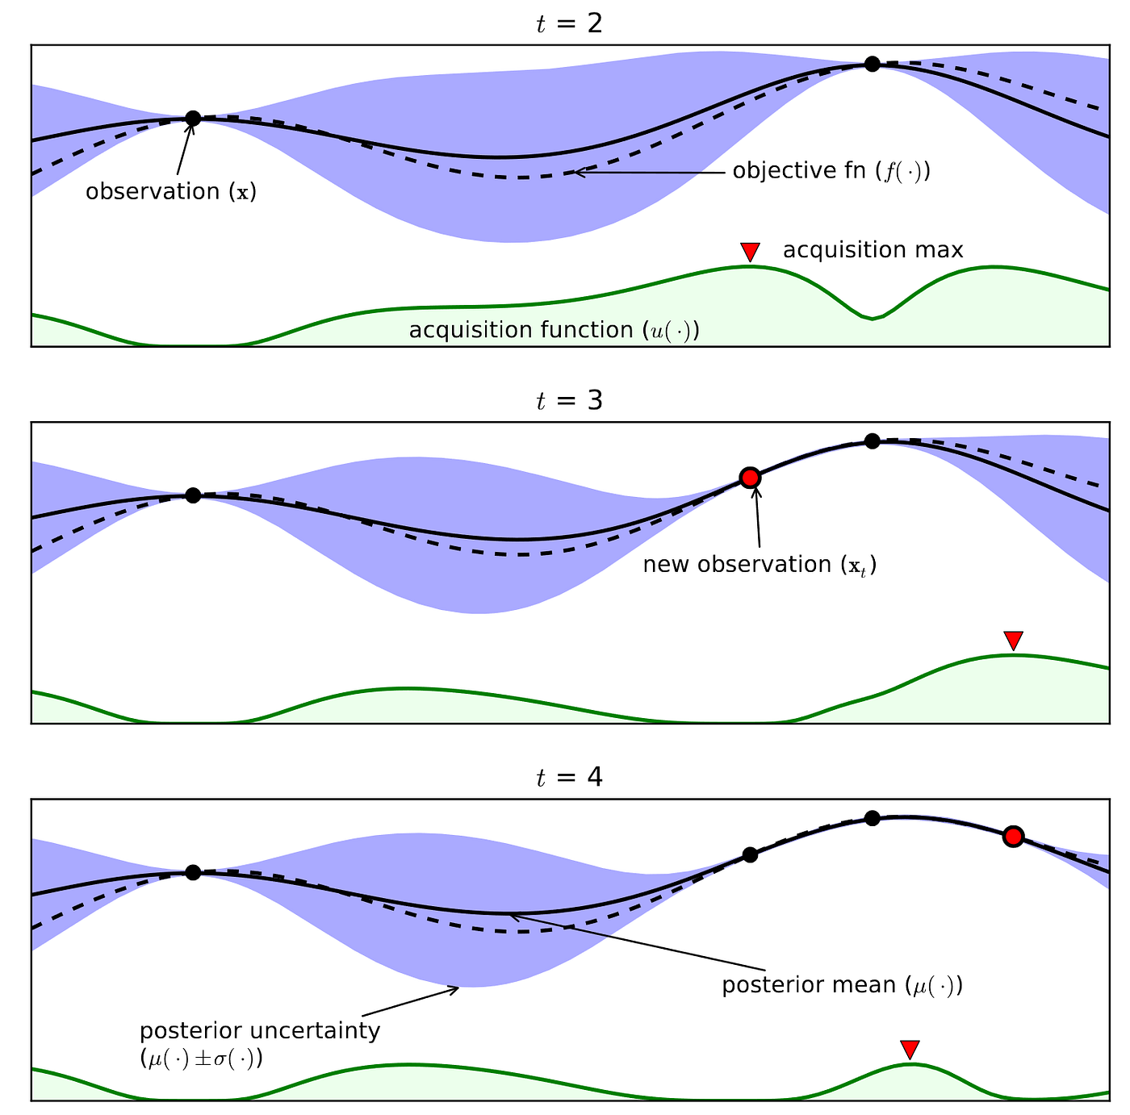
Physics-Informed Optimization
Physics-based methodology to exploit limit cycles
Universal Modeling for Nonlinear Multi-cavity Systems
Bayesian Optimization
Optimal Parameters
magnitude (a.u)
frequency (a.u)
Suntharalingam, A., et al. Nat Commun 14, 5515 (2023)
Notes:
Exploit inherit complexity of dynamical systems with few degrees of freedom
Mathematical tools that describes linearized dynamics, indicator of degree of complexity

Slide 6
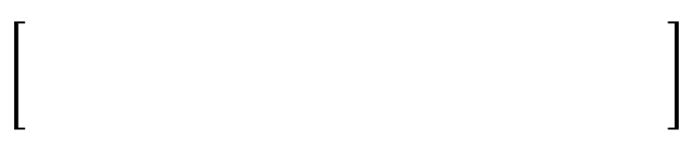
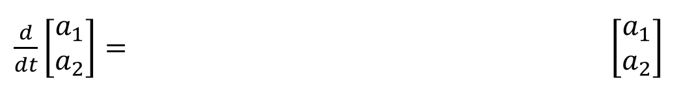
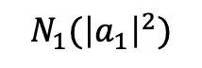
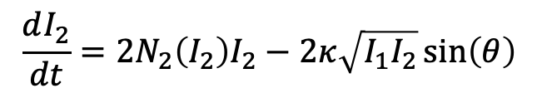

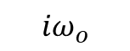
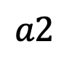
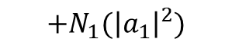

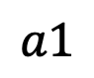

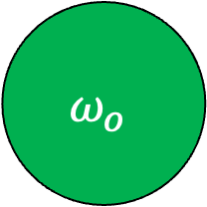
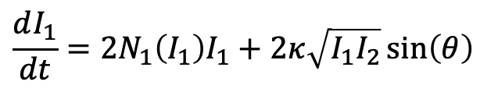
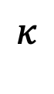
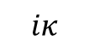

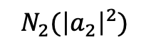
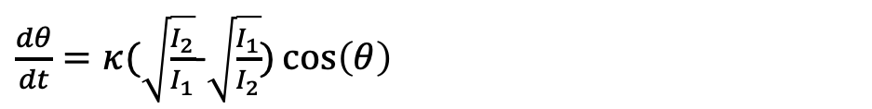
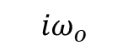
Universal Modeling: Coupled Mode Theory (CMT)
$$a1$$
$$a2$$
Multi-cavity Systems
$$ω_{o}$$
$$κ$$
$$ω_{o}$$
$$N_{1}({\left|a_{1}\right|}^{2})$$
$$N_{2}({\left|a_{2}\right|}^{2})$$
$$+N_{1}({\left|a_{1}\right|}^{2})$$
$$iκ$$
$${iω}_{o}$$
$${iω}_{o}$$
$$iκ$$
$$+N_{2}({\left|a_{2}\right|}^{2})$$
In polar coordinates,
$$\frac{dI_{1}}{dt}=2N_{1}\left(I_{1}\right)I_{1}+2κ\sqrt{I_{1}I_{2}}\sin\left(θ\right)$$
Where $a_{n}\left(t\right)=I_{n}^{\frac{1}{2}}\left(t\right)e^{iφ_{n}\left(t\right)}$ and $θ=φ_{2}−φ_{1}$
$$\frac{dI_{2}}{dt}=2N_{2}\left(I_{2}\right)I_{2}−2κ\sqrt{I_{1}I_{2}}\sin\left(θ\right)$$
$\frac{dθ}{dt}=κ(\sqrt{\frac{I_{2}}{I_{1}}}$-$\sqrt{\frac{I_{1}}{I_{2}}})\cos\left(θ\right)$
Notes:
Change animation
Natural coordinates for coupled mode theory. Of course in the coupled mode theory description, the fields a1 and a2 are complex, which cause degrees of difficulty in the analysis. A natural representation of the same set of equations is the polar coordinates, in which the complex fields are represented by intensities and phases. In this presentation, the dynamical system analysis becomes more attractive.

Slide 7
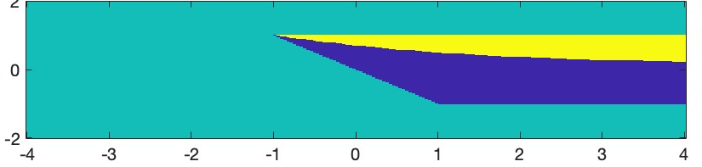
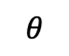
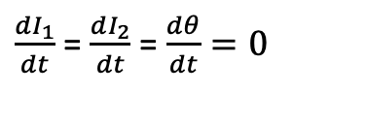

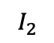
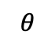
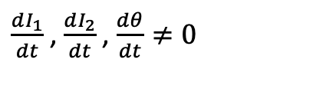
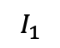
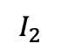
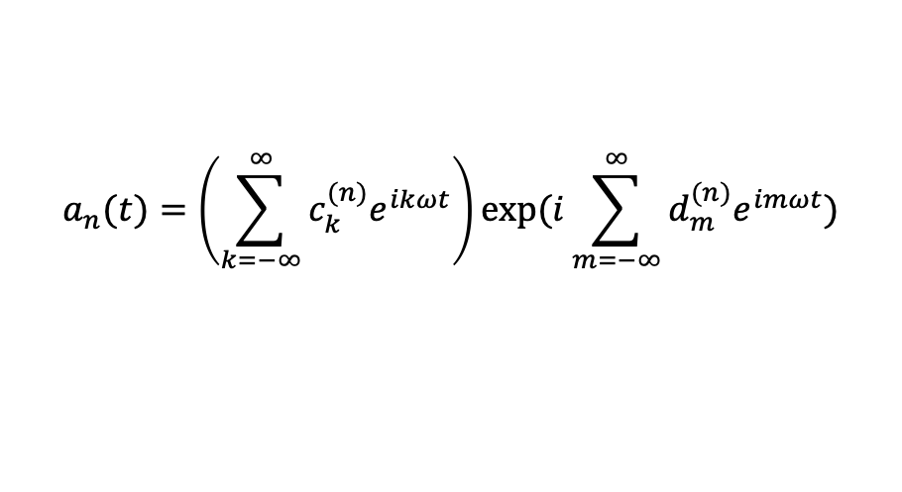
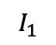
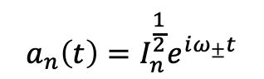
Dynamical State Classification
param1
I. Fixed points solutions:
II
Unbounded/trivial
$\frac{dI_{1}}{dt}$ = $\frac{dI_{2}}{dt}$ = $\frac{dθ}{dt}=0$
I
$$a_{n}\left(t\right)=I_{n}^{\frac{1}{2}}e^{iω_{±}t}$$
param 2
I.
II.
II. Limit cycle solutions:
$$θ$$
$$θ$$
$\frac{dI_{1}}{dt}$ , $\frac{dI_{2}}{dt}$ , $\frac{dθ}{dt}≠0$
$$I_{1}$$
$$I_{2}$$
$$I_{1}$$
$$I_{2}$$
$$a_{n}(t)=\left(\sum_{k=−∞}^{∞}{c_{k}^{(n)}e^{ikωt}}\right)exp⁡(i\sum_{m=−∞}^{∞}{d_{m}^{(n)}e^{imωt}})$$
Challenge:
The coefficients $c_{k}^{(n)}$ and $d_{m}^{(n)}$ are analytically intractable
Notes:
Before moving on, with deploying my approach to engineer limit cycles, I had made sure that my simple system is complex enough to support such type of structures. Here I am showing you a parameter space characterization of the dynamical complexity. For a set of parameters I have identified a domain 1 indicated by blue where the dynamics is not interesting as it correspond to fixed points. In other words, there are no limit cycles. Instead, there is another domain highlighted with yellow where limit cycles can be found. I will show you an engineering protocol which is designed to navigate through this complex parameter space targeting the yellow interesting domains.

Slide 8
Physics-Informed Optimization
Physics-based methodology to exploit limit cycles
Universal Modeling for Multi-cavity Systems
Bayesian Optimization
Suntharalingam, A., et al. Nat Commun 14, 5515 (2023)

Slide 9
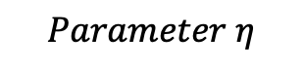




Bayesian Optimization
Task:$\min_{\vec{η}∈ℝ^{d}}{Loss\left(\vec{η}\right) subject to\max\left({Re[λ}_{J}(\vec{η})]\right)≥0}$
Limit cycle condition
Physics-Agnostic
Iteration 0
Initialization
$$Loss\left(\vec{η}\right)$$
Sample
Iteration 1
Sample
$$Expected Improvement$$
$$Loss\left(\vec{η}\right)$$
Update
Sample
Iteration 2
$$Loss\left(\vec{η}\right)$$
$$Parameter η$$
Notes:
Add more explanation for the loss function
Change uncertainty for step 3

Slide 10
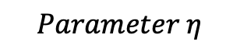
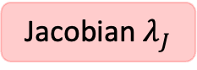







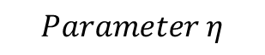
Bayesian Optimization
Task:$\min_{\vec{η}∈ℝ^{d}}{Loss\left(\vec{η}\right) subject to\max\left({Re[λ}_{J}(\vec{η})]\right)≥0}$
Limit cycle condition
Physics-Agnostic
Iteration 0
Physics-Informed
$$Loss\left(\vec{η}\right)$$
Iteration 0
$$Loss\left(\vec{η}\right)$$
Sample
Iteration 1
Jacobian $λ_{J}$
$$Expected Improvement$$
$$Loss\left(\vec{η}\right)$$
$$Expected Improvement$$
Sample
Iteration 1
Iteration 2
$$Loss\left(\vec{η}\right)$$
Sample
$$Loss\left(\vec{η}\right)$$
$$Parameter η$$
$$Parameter η$$

Slide 11
Physics-Informed Optimization
Physics-based methodology to exploit limit cycles
Universal Modeling for Multi-cavity Systems
Bayesian Optimization
Optimal Parameters
magnitude (a.u)
frequency (a.u)
Suntharalingam, A., et al. Nat Commun 14, 5515 (2023)

Slide 12
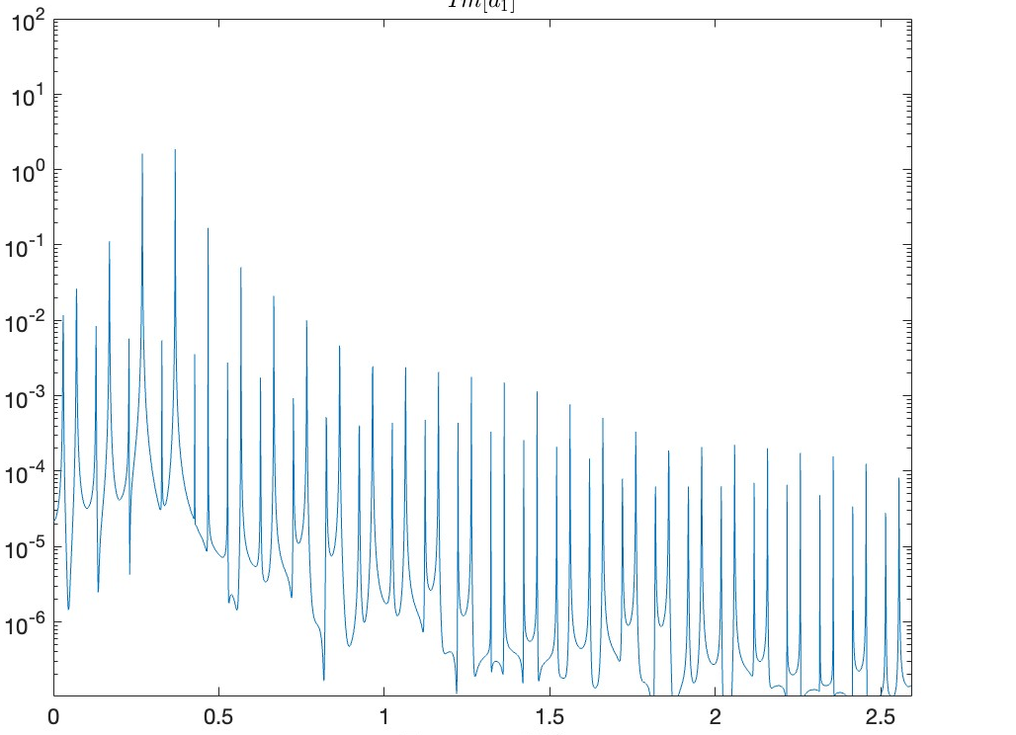
Results: Coupled Mode Theory (CMT)
Single dimer
Two dimers
Magnitude
Magnitude
Frequency (Hz)
Frequency (Hz)

Slide 13
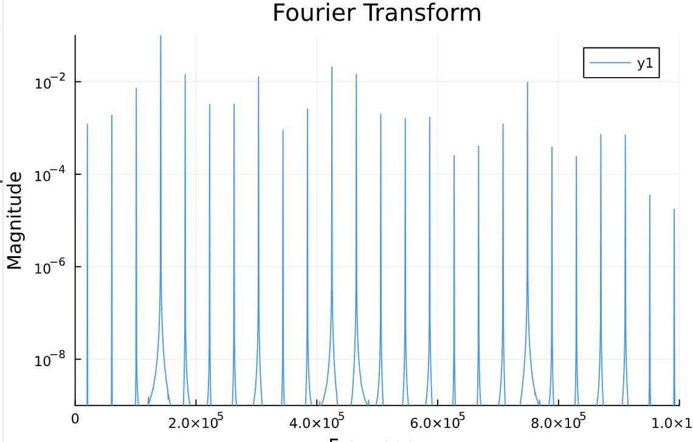
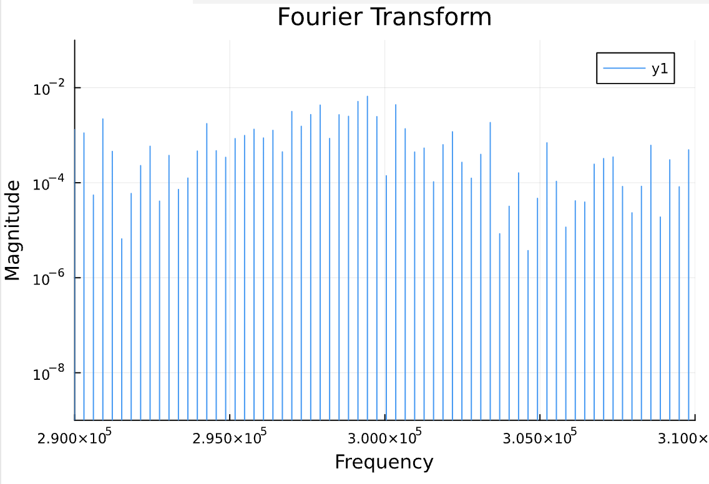
Results: Realistic Circuit Simulation (NGSpice)
Single dimer
Two dimers
Notes:
Add CMT results

Slide 14
Thank you!

Slide 15
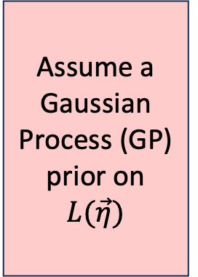


Bayesian Optimization
Task:$\min_{\vec{η}∈ℝ^{d}}{L\left(\vec{η}\right) subject to\max\left({Re[λ}_{J}(\vec{η})]\right)≥0}$
Limit cycle condition
No
Assume a Gaussian Process (GP) prior on $L(\vec{η})$
Evaluate Loss at $\vec{η}$ that maximizes Expected Improvement
Update GP by computing conditional distribution
Reached termination criterion?
Yes
End
Physics
Jacobian Information
$L\left(\vec{η}\right)$~$𝒢𝒫(m\left(\vec{η},λ_{J}\right), k\left(\vec{η},{\vec{η}}^{′}, λ_{J}\right))$

Slide 16
Bayesian Optimization
Brochu, E., et al. Retrieved from https://arxiv.org/abs/1012.2599
Notes:
Combine 10 and 11
Keep 2
Make comparison between physics-agnostic and physics -informed

